Slide 1
Audit software-based methodologies – how is technology transforming the audit
Aneta Wilk-Lys
Kyiv 29 September 2017

Slide 2
Agenda
Audit documentation – importance, mitigation of risks
Paper based versus electronic files
Audit tools
Change from paper to electronic based – big challenge and great help
Using software based methodologies for training and teaching audit standards and their practical application

Slide 3
Audit documentation – ISA 230
Documentation that meets the requirements of ISA:
Evidence of the auditor’s basis for a conclusion about the achievement of the overall objectives of the auditor
Evidence that the audit was planned and performed in accordance with ISAs and applicable legal and regulatory requirements
Assisting the engagement team to plan and perform the audit
Assisting members of the engagement team responsible for supervision to direct and supervise the audit work
Enabling the engagement team to be accountable for its work
Retaining a record of matters of continuing significance to future audits
Enabling the conduct of quality control reviews and inspections
Enabling the conduct of external inspections

Slide 4
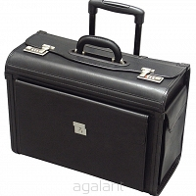
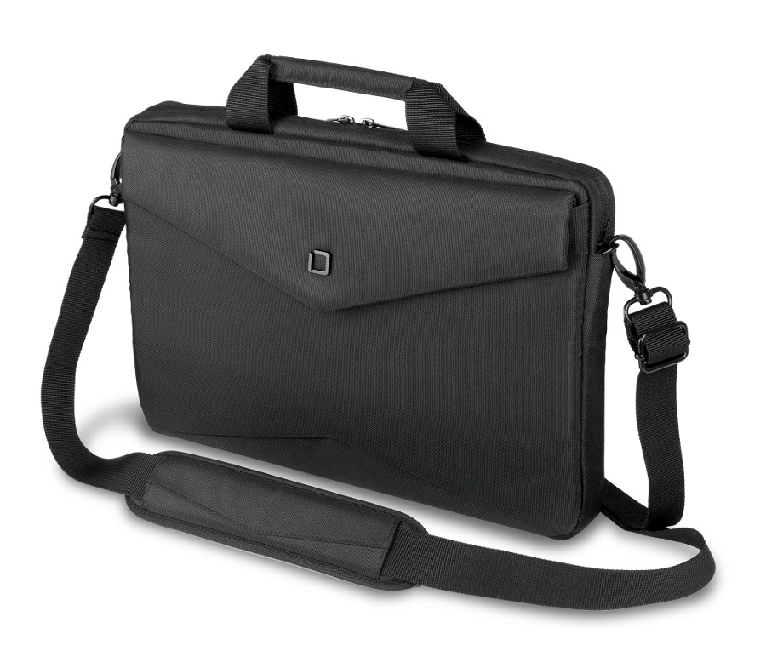
Paper based versus electronic files
CHOICE

Slide 5
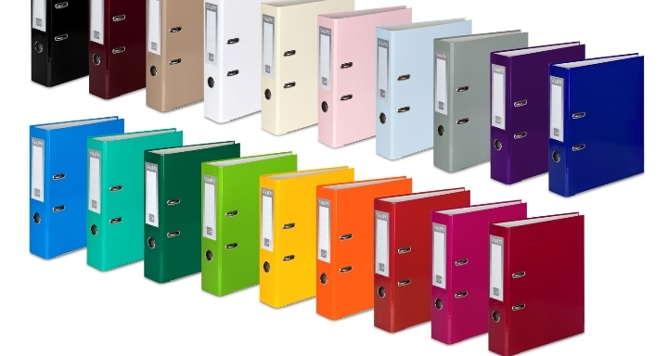



Paper based versus electronic files

Slide 6
Audit tools
Tailored products of international network audit companies
Commercial products available in the market (Datev, Caseware, Descartes, U-Fin, others)
Use of Excel, Word etc.

Slide 7
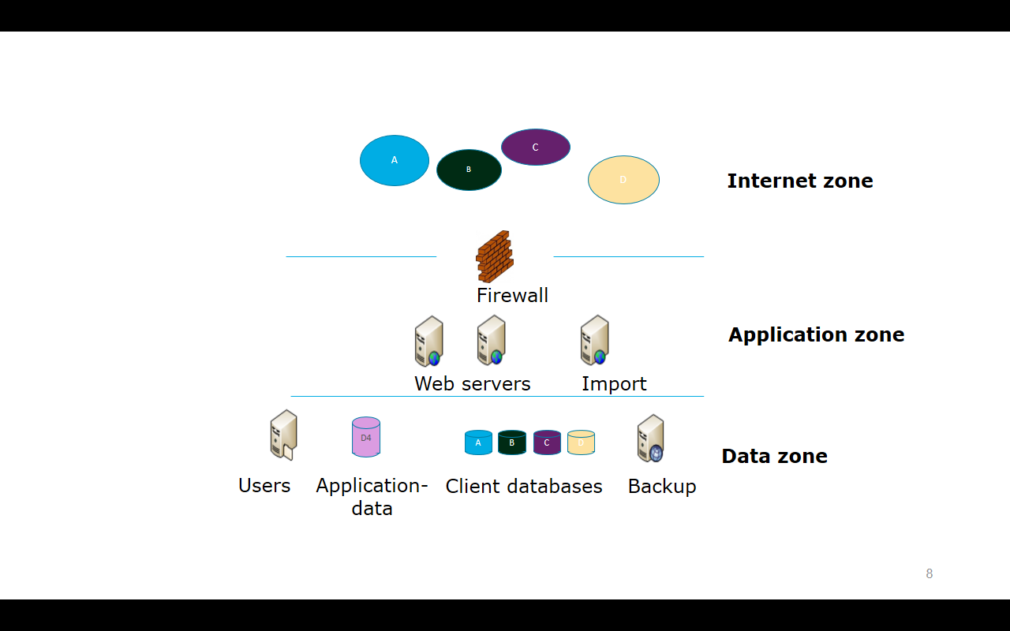
Audit tools based in Cloud

Slide 8
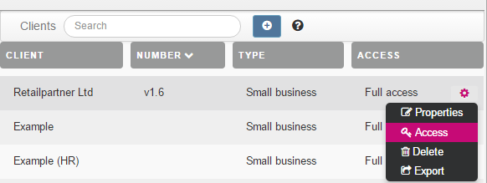
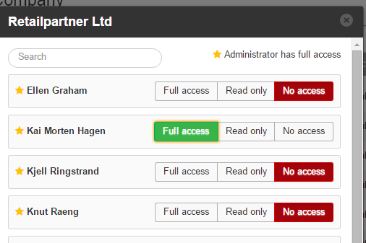
Example menu - access to engagements

Slide 9
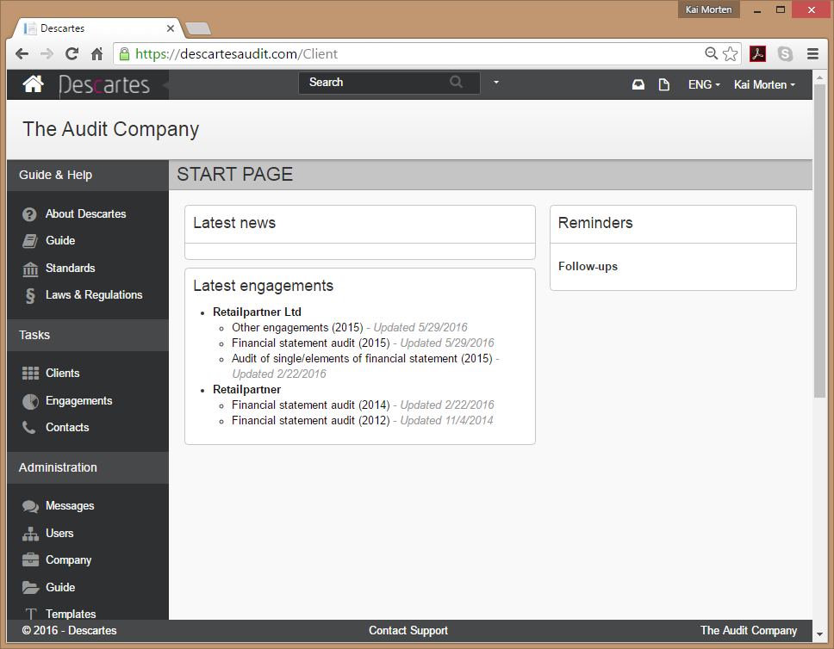

Slide 12
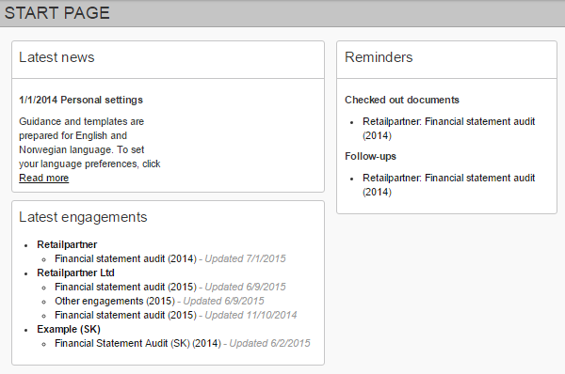
Top menu
Main window

Slide 13
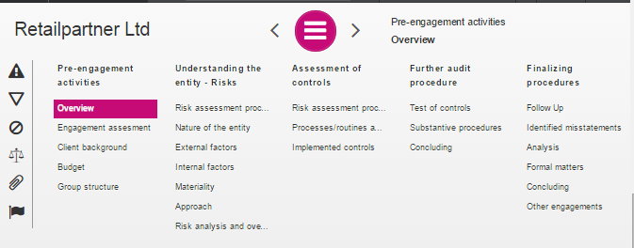
Navigation menu

Slide 14
Documenting
Retail Partner Ltd., medium sized entity.
Address: Sienna 123, Warszawa
Magreement board: Mimi Rogers (Chairman), Roger Moore (Finance Director)
Company Number: 123456789
Tax identity: 22222222222

Slide 15

Audit tools – my experience
Although initially it seemed impossible, difficult and unnecessary complication, it finally turned out to be tool, that no one could live without.
Easy menu, helps to keep order of performer tasks
Available templates, including required formats of audit reporting - helps forming audit opinion or other reports as needed as well as summarize key audit matters and EAR- extended audit reporting
Track of review and all records done, which supports completeness of obligatory tasks and helps remember all the work that needs to be done (of course this does not replace professional judgement)
Great tool to comply with ISAs because it guides users through necessary steps reuired by standards
Possibility of attaching documents in Power point, Word, Excel or other applications
Available audit standards and law regulations
Excellent security and back ups
On line access to updated documentation for review purposes
Available documentation from prior audits

Slide 16

Audit tools – my teaching experience
Understanding ISA at early stage (studying on university) is a key step to be successful in applying standards in practice in the future.
The World Bank (CFRR team), as part of Swiss Contribution project, managed to run some educational projects aimed at promoting ISA and audit tools generally among students on some Polish universities.
Companies often are ready to give free access to demo versions to be used for teaching purposes
This is a great possibility to support training and teaching on universities and finally get people used to electronic solutions which they successfully use in the future.

Slide 17
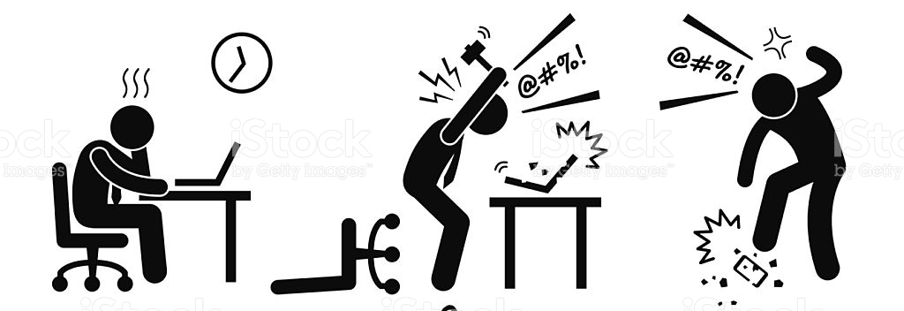
Change from paper to electronic based challenge and convenience

Slide 18

Change from paper to electronic based challenge and convenience

Slide 19
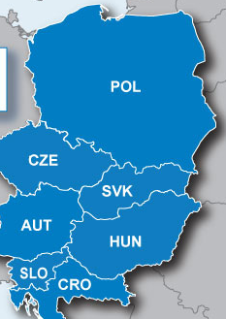
Polish (and not only) experience
Professional bodies (like National Chambers of Auditors) are able to help auditors with getting access to audit software;
Thre are plenty of solutions available on the Polish market, but PIBR did not want to support any particular, because there was a fear this would distort competition on the market;
finally negotiations related to the tool developed by one of the professional bodies outside the country failed in Poland;
Slovenia is an example of a small audit market. Despite this, they decided to go for the solution and auditors started to use it, however significant help was needed at the beginning to make them understand the tool well;

Slide 20
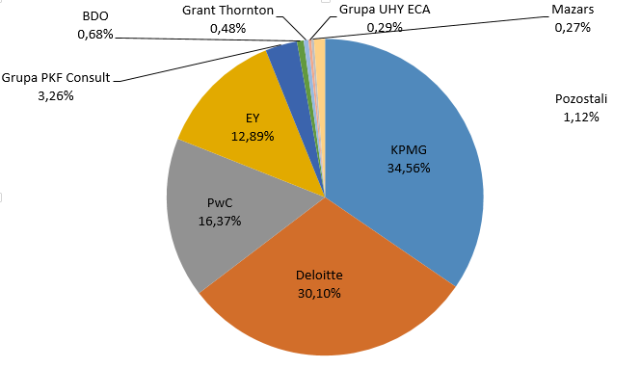


Polish experience – some statistics
Audit market in Poland based on assets audited
Top ten audit companies (based on numer of audits)
ca 7 thousand auditors
ca 3 thousands active auditors
Average age, 55

Slide 21

If you are interested in such type of solution, we are able to help you (at least with some advice about range of possibilities and how to start).

